Slide 1

DIGIT RECOGNIZER
Mastering Digit Recognition: An Introduction to Computer Vision Techniques with MNIST Data on Kaggle
Master in Digital Technology and Innovation Management
AstroDave, Will Cukierski. (2012). Digit Recognizer. Kaggle.
https://kaggle.com/competitions/digit-recognizer.
Jennifer Aldana|Carolina Leuzzi|Stephen Kalman|Mario Mirabile |Riccardo Sartorelli

Slide 2
Our Pipeline: Digits Recognition Project
Our objective was to build a model that could accurately recognize handwritten digits. To achieve this, we implemented a structured work plan project that comprised of the following essential milestones:
Exploratory analysis:
Discovering MNIST dataset insights for informed modeling.
Visualizing sample digits to understand data representation.
Analyzing digit class distribution using histograms.
Analyzing digit intensity distribution.
Analyzing digit “4” representation.
Applying PCA to reduce dimensionality and extracting its features.
Modeling:
Importing libraries and load data;
Preprocessing and visualize the data;
Performing PCA to reduce dimensionality;
Using GridSearchCV to find the best hyperparameters for RandomForestClassifier;
Evaluating the classifier and plot feature importances;
Predicting labels for the test set and create a submission file;
Visualizing test images and display predicted labels.

Slide 3
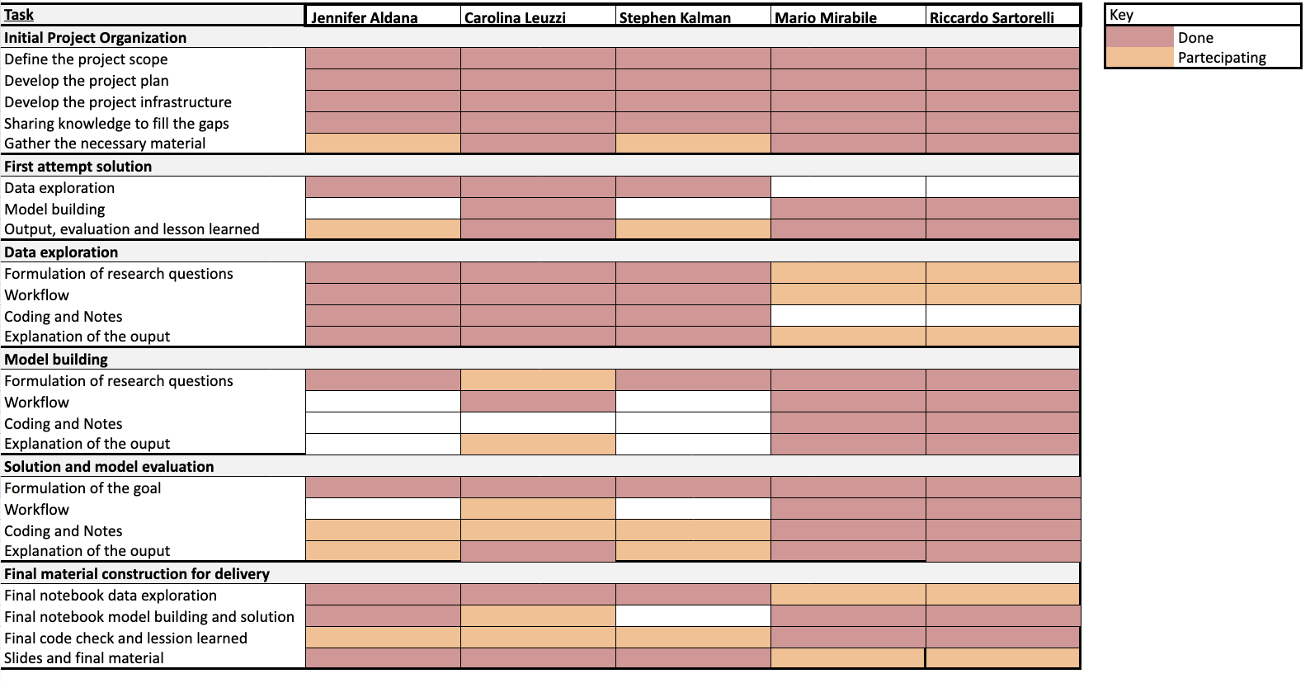
RACI: Framework Used to Assign Roles and Tasks in a Project

Slide 4
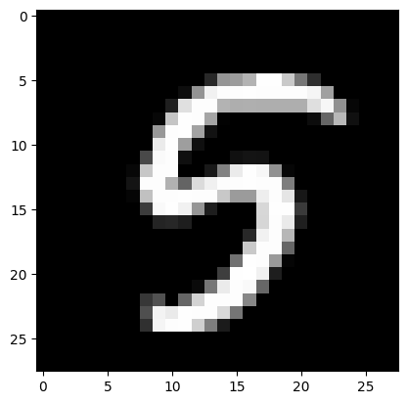

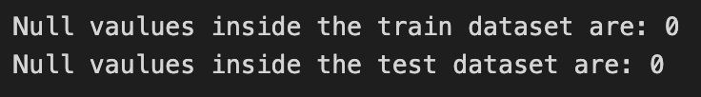
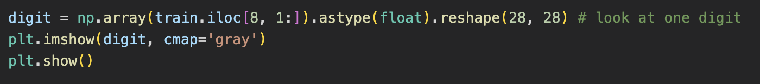
a.1|2 Data Exploration: Visualizing the Dataset
Display dataset size and missing values.
By using matplotlib library we displayed the digits as a grayscale image.

Slide 5
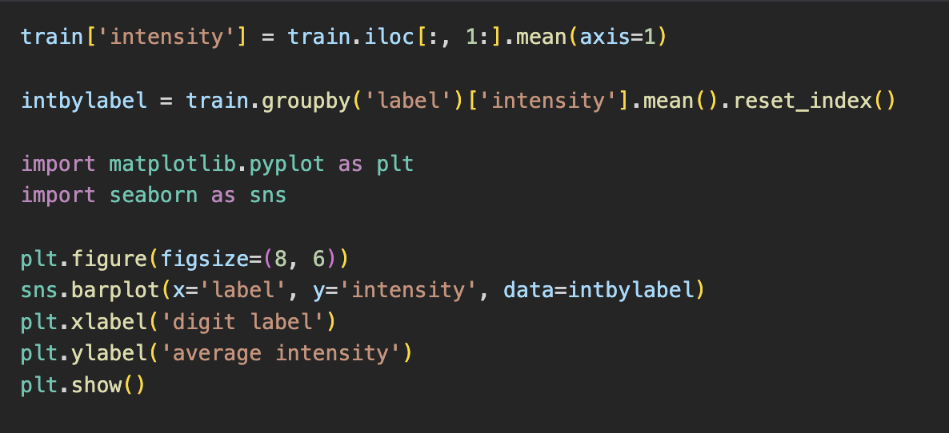
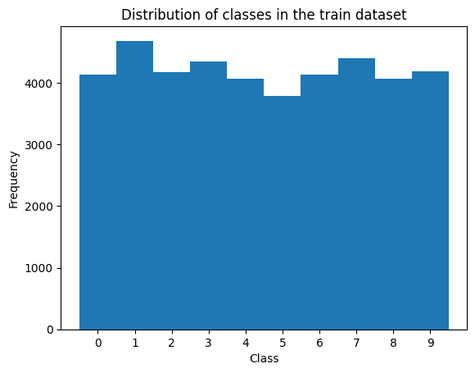
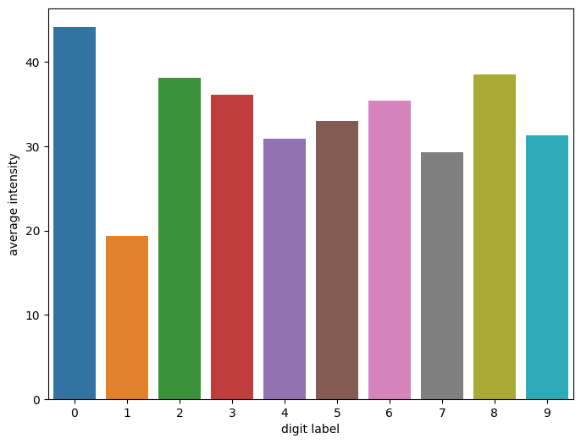
a.3 Data Exploration: Digits Intensity Analysis & Visualization
Labels of the train set are well balanced.
Computation of the average intensity of the digits in the training set and grouping them by label.
Checking the distribution of the classes of the digits in the dataset.
Visualization of the average intensity for each digit by creating a bar plot using the seaborn library, with the digit label on the x-axis and the average intensity on the y-axis.
The brightness of digits varies with "1" being the least bright and "0" the brightest (variations due to differing writing styles).

Slide 6
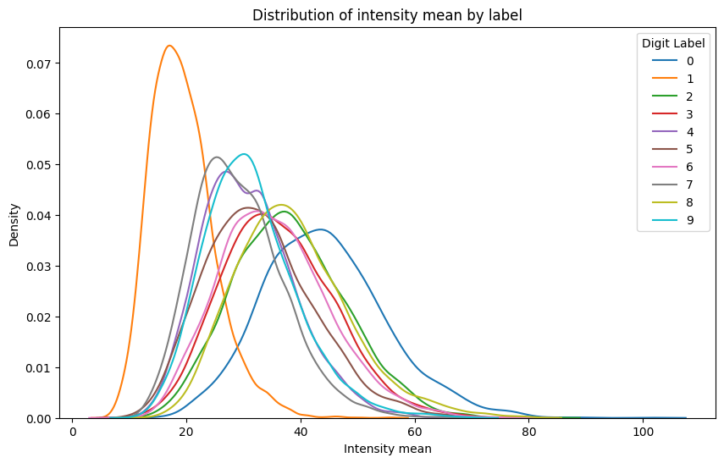
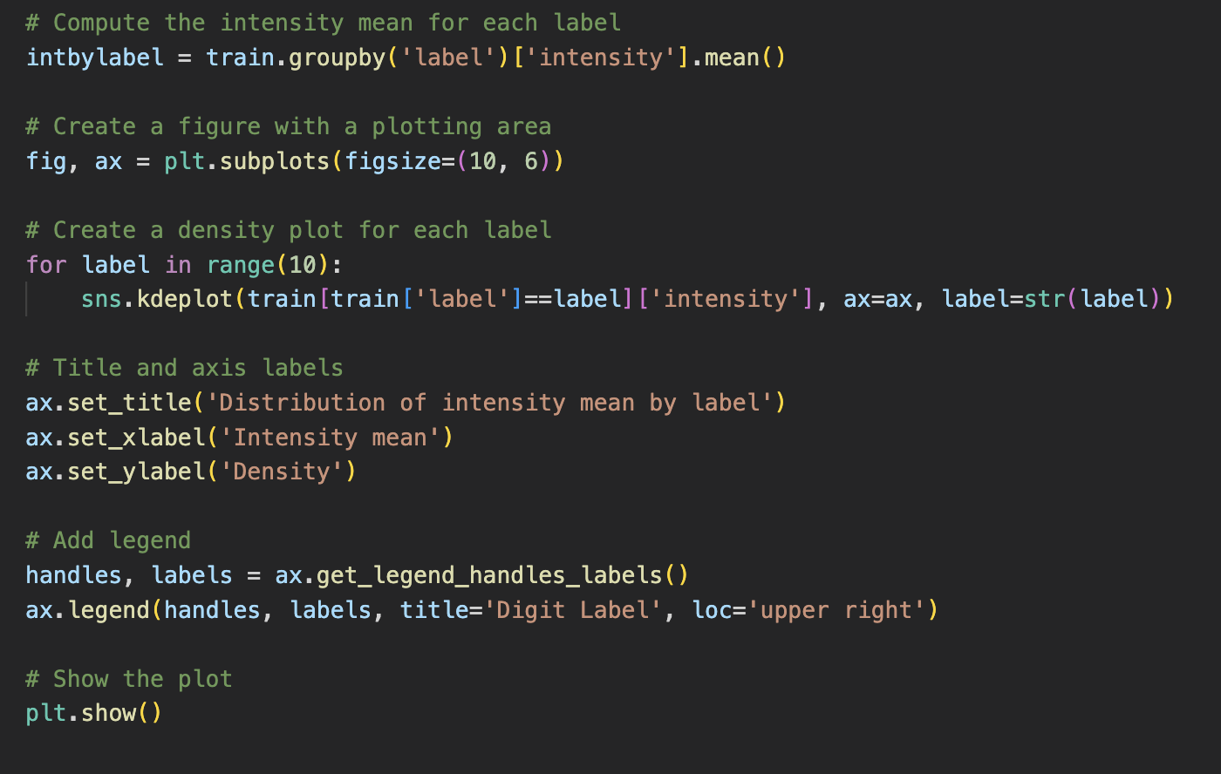
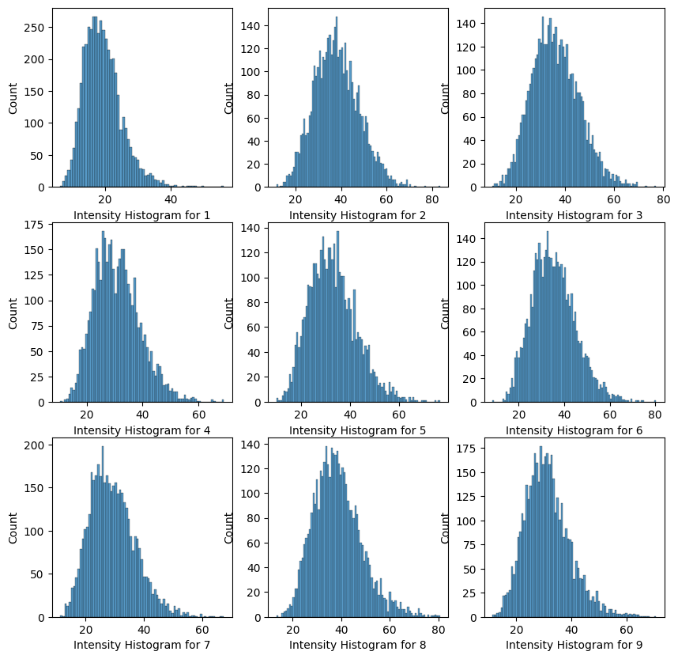
a.4 Data Exploration: Label Intensity Visualization with Seaborn
Intensity distributions of most digits are normally distributed, but some have higher variability than others.
Digit "1" is consistently written across all samples, while digit "4" has less normal distribution due to different ways of writing it.
Further investigation will be done by visualizing images of digit 4 to confirm the hypothesis.

Slide 7
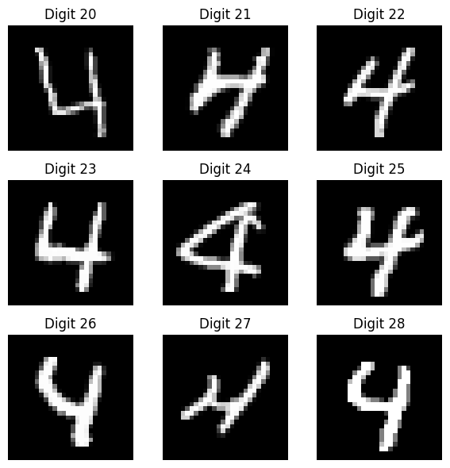
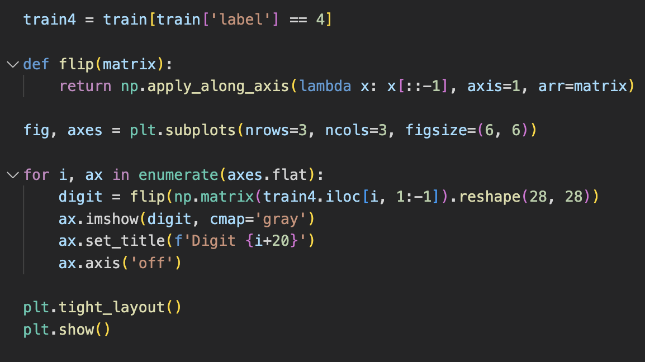
a.5 Data Exploration: Variability of digit “4”
Creation of a new dataset called "train4" containing only the images of the digit 4.
Different ways of writing the digit “4”, either closed or opened at the top, contribute to its variability.

Slide 8
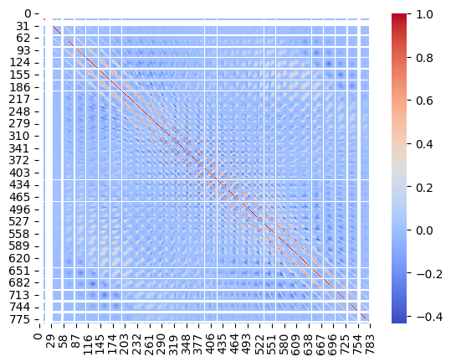
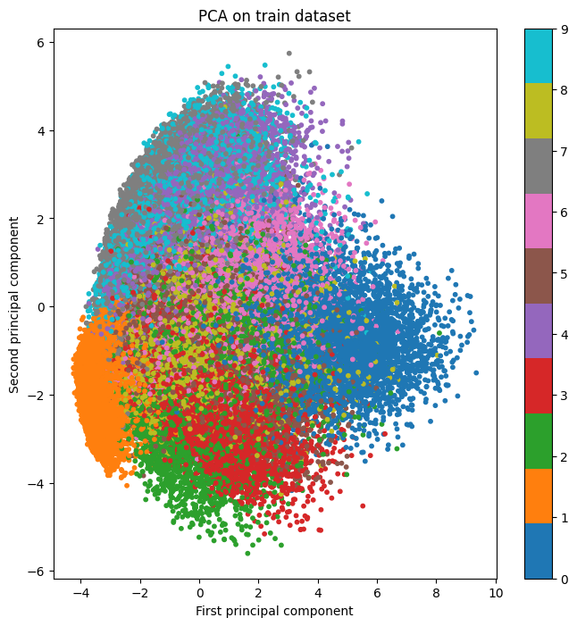
a.6 Data Exploration: Heatmap and PCA
Calculation of correlation matrix to measure the linear relationship between pixel values.
Creation of heatmap to visualize the correlation matrix, providing insight into the pixel value patterns.
PCA to the preprocessed data to reduce dimensionality and extract the most important features.
Plot the reduced data on a scatterplot in which each dot represents a digit, where the color indicates its corresponding label.
In this case, the variance explained is 0.169, which suggests that the two principal components only capture a small amount of the overall variability in the data.

Slide 9
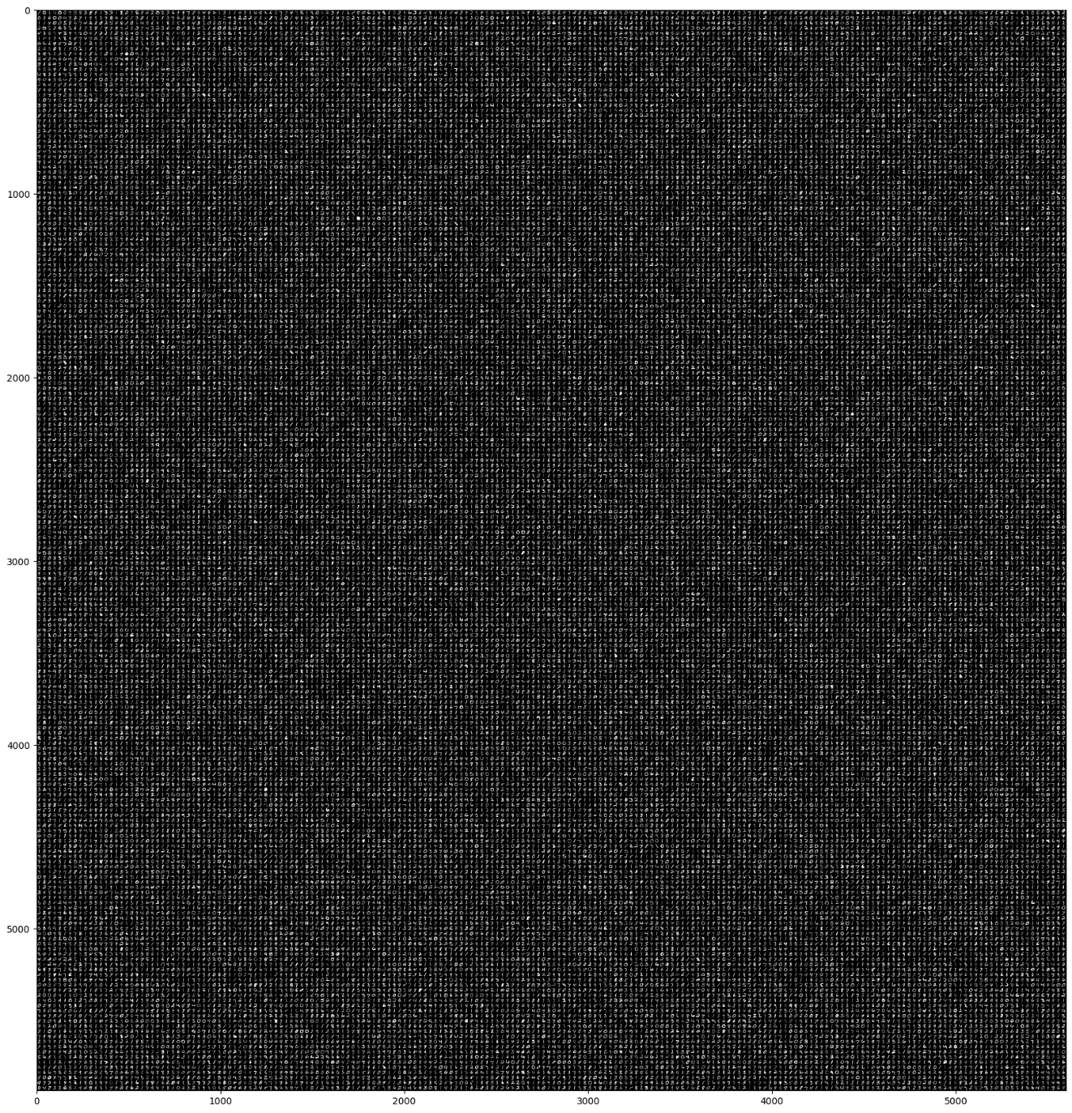
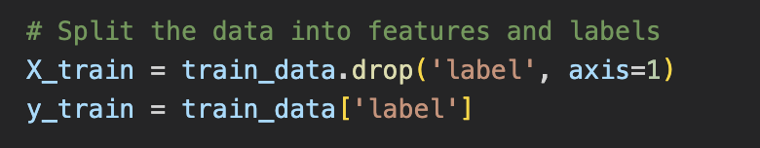
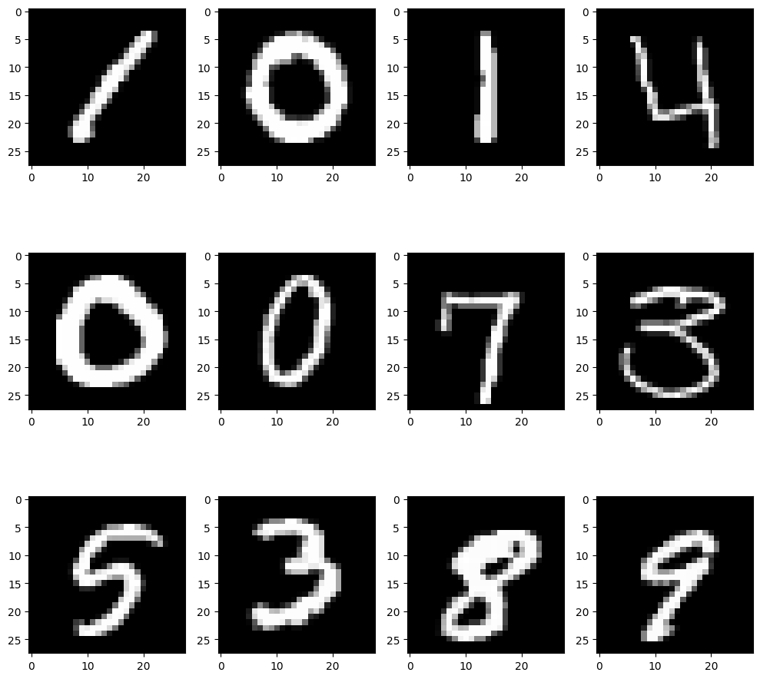
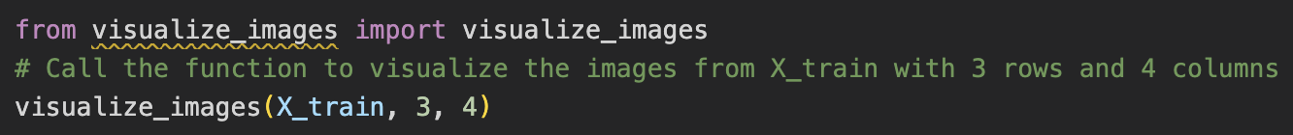

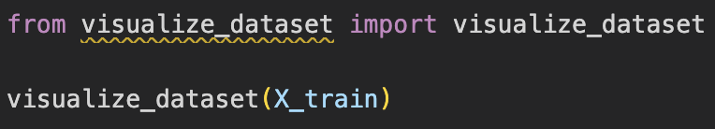
b.1|2 Data Preparation: Label Separation & Pixel Visualization
We imported necessary libraries and loaded csv data.
Dropping the column “label” from the training data and stored it in the y_train variable, while the features were stored in the X_train variable.
Displaying a grid of 3 rows and 4 columns with images from the training set.
Creating a histogram and showing the distribution of the pixel values in the images.

Slide 10
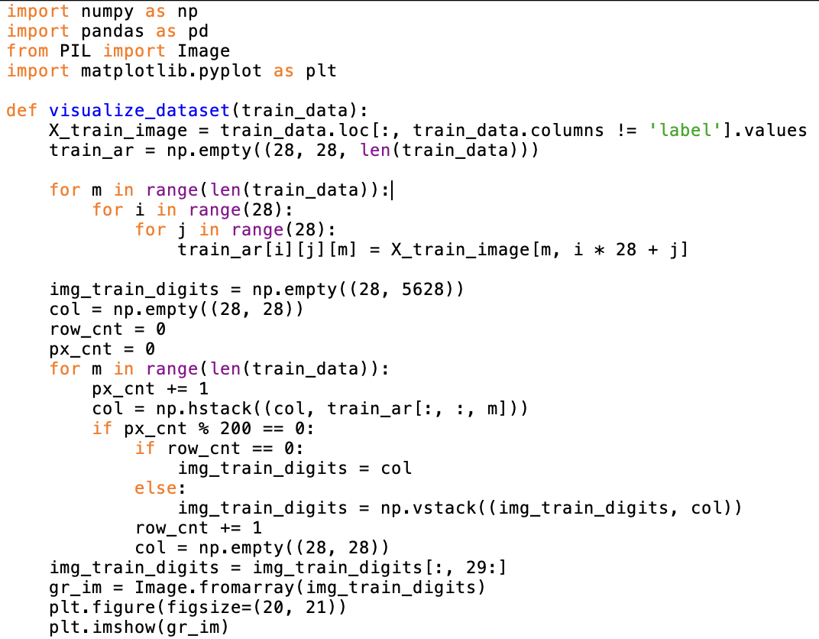
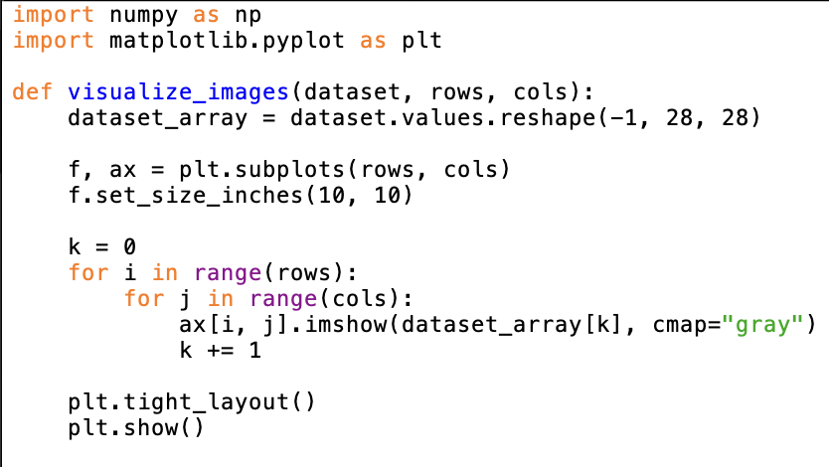
b.2 Data Preparation: Digit Visualization Functions
1.
This function visualizes the entire MNIST dataset by concatenating digit images into rows of 200, stacking these rows vertically, and displaying the resulting grid with matplotlib.
Source: https://github.com/mitsyprada/kaggle-digit-recognizer/blob/main/code.ipynb
2.
Inspired by the previous function we created our own. We wanted to visualize a grid of digit images from the MNIST dataset by reshaping the data, plotting the images in a specified number of rows (3) and columns (4), and displaying the grid using matplotlib.

Slide 11
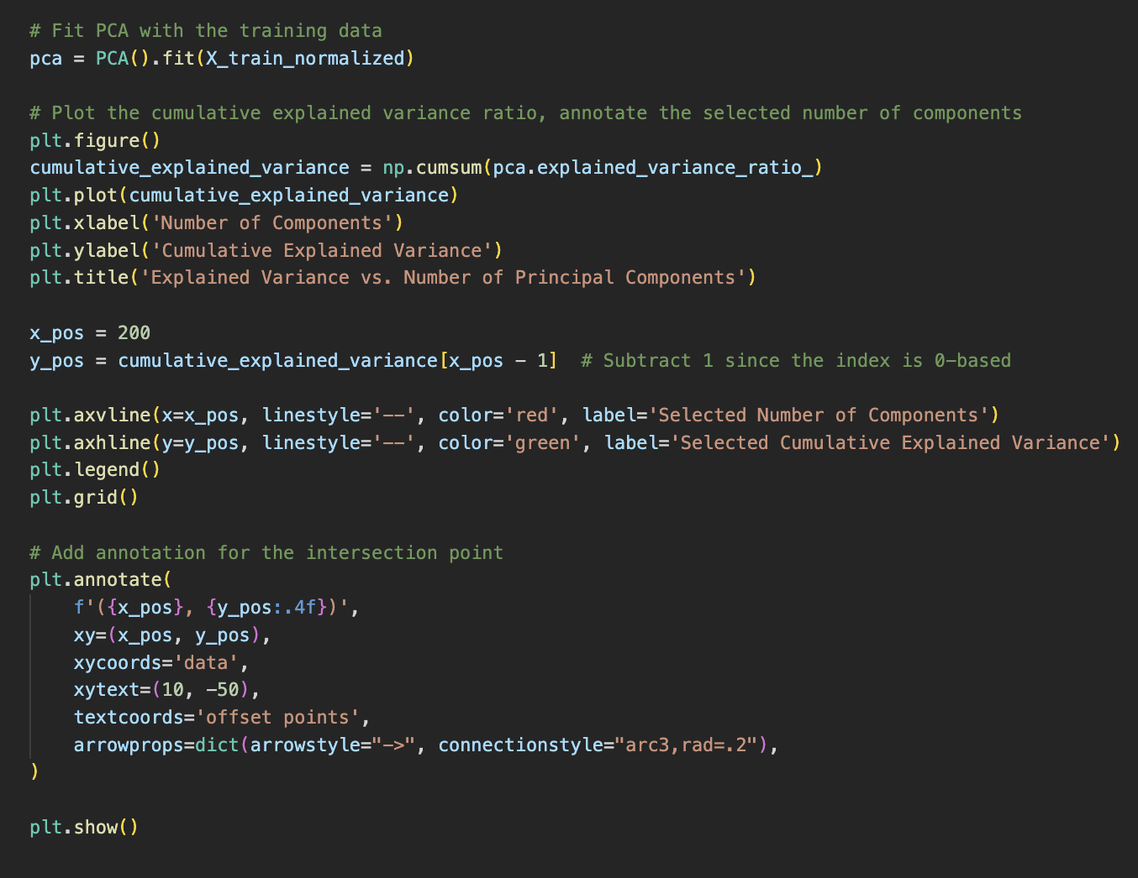
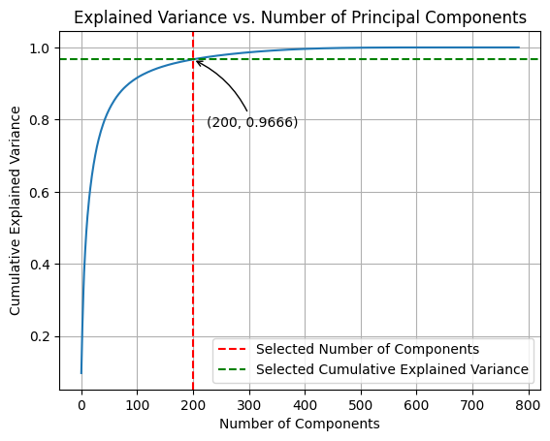
b.3. Dimensionality reduction: Cumulative Variance Ratio Optimization
Reduction of the dimensionality of the data by fitting the normalized training data with the PCA
Normalize the data by dividing each pixel value by 255.
The snippet shows a code performing PCA on normalized data, plotting the cumulative explained variance (green), and highlighting the chosen components (red).

Slide 12
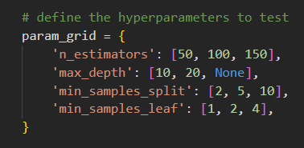
b.4 Model Definition & Optimization
Discovering the best models for image recognition using ML techniques (no DL).
We found that the best model for our project is Random Forest Classifier (vs. LogReg).
We defined the best hyperparameters.
The following code defines a hyperparameter grid, performs a 5-fold cross-validated grid search for a Random Forest Classifier using 4 concurrent jobs, and outputs the best model and its parameters with the elapsed time.

Slide 13
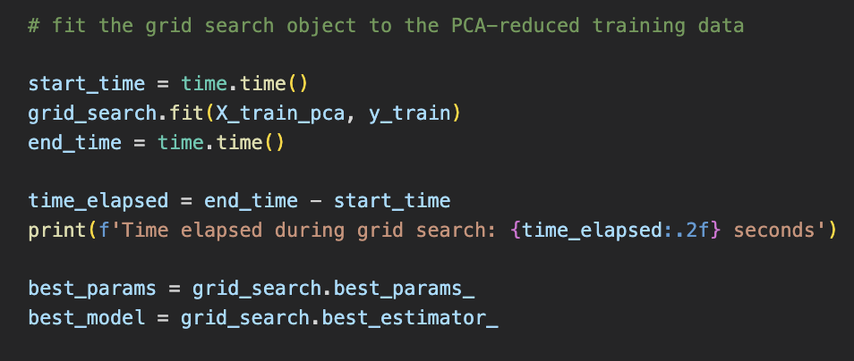

b.4 Model Definition & Optimization
The following code fits a grid search object to PCA-reduced training data. Also, it calculates and displays the elapsed time, and extracts the best model and its parameters.
Then, we printed the best hyperparameters:
The “None” value as a hyperparameter in this context means:
It refers to the 'max_depth' parameter in a decision tree-based model.
When set to 'None', there is no limit on the depth of the tree.
The tree can continue growing until all leaves are pure or contain fewer samples than 'min_samples_split'.
The grid search took 9,534 seconds (approximately 2 hours and 39 minutes) to find the optimal model and its parameters!!!

Slide 14
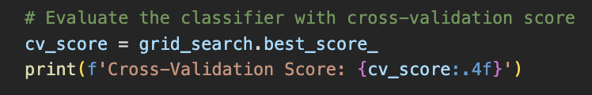

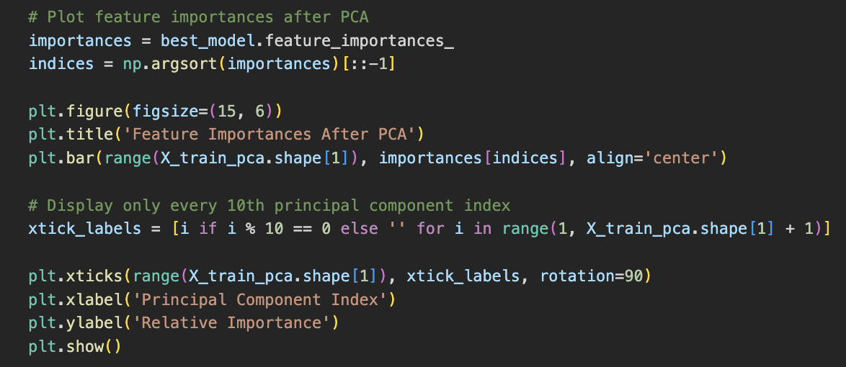
b.5 Evaluation of the classifier
Print the best grid search score using cross-validation.
The code visualizes feature importance post-PCA with a bar chart, showing principal component indices and their importances, while displaying every 10th index components (see next slide).

Slide 15
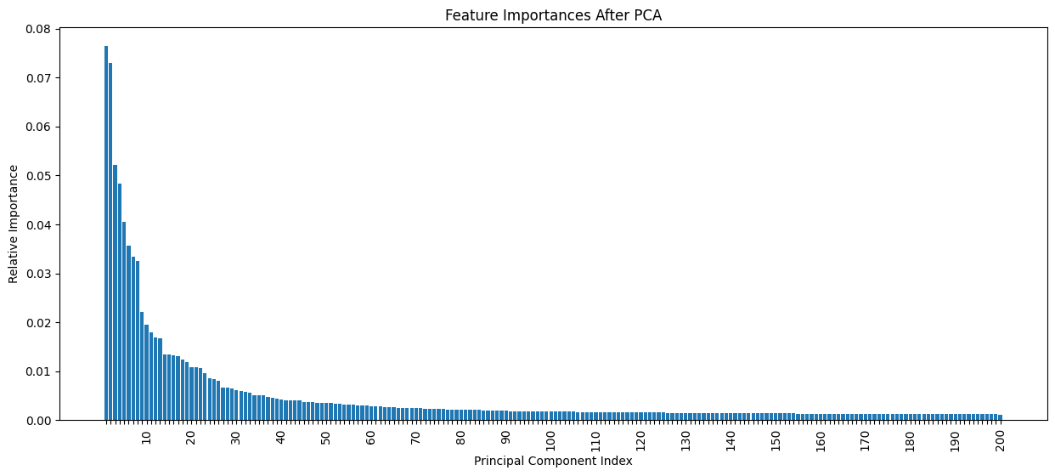
b.5 PCA-derived Feature Importance in Random Forest
Upon reaching 100 principal components, the bar plots flatten, indicating a lower relative importance of the subsequent components.

Slide 16

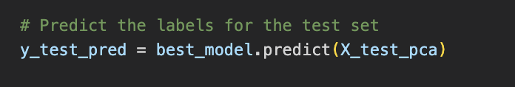
b.6 Predict Labels for the Test Set and Create a Submission File
We applied PCA to normalize test data and reduce dimensionality.
So, we predicted labels for the test set using the best model found with: best_model = grid_search.best_estimator_
Finally, we created a submission file with ImageId and predicted Label, saving it as 'submission.csv'.

Slide 17

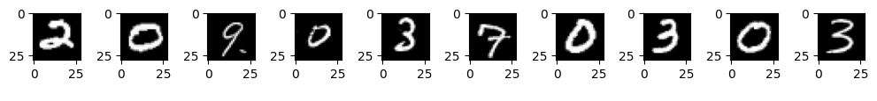
b.7 Visualize test images and display predicted labels.
Load submission data.
Extract and display the first 10 predicted labels.
Print the first 10 labels horizontally.
Visualize the corresponding 10 test images.

Slide 18
Achievements and lessons learned
Achievements
Achieved 0.9416 cross-validation accuracy using PCA and RandomForestClassifier.
Some misclassification (e.g., "0" as "4") observed, suggesting room for improvement, as explained by the explanatory analysis.
Consider experimenting with deep learning models (e.g., TensorFlow) to enhance accuracy.
Deep learning may also improve processing times and optimize the overall process.
The utilization of GridSearchCV to optimize RandomForestClassifier's hyperparameters led to an effective model, although the process resulted in substantial computing time, emphasizing the need for striking a balance between model efficiency and computational resource requirements.
Lessons learned
We encountered challenges in digit recognition due to the reliance on pixel brightness and the complexity of preprocessing the data, highlighting the need for robust techniques to improve accuracy and efficiency.
We understood that the data augmentation can be a powerful tool for improving the accuracy and performance of a machine learning model, and it's important to experiment with different techniques to find the most effective approach.
Notes:
¡

Slide 19
THANK YOU FOR YOUR ATTENTION!
Notes:
¡

